Slide 1
Stock Price Predictions with Machine Learning Models
Pardeep Kumar
Mentor: Dipanjan Sarkar
Capstone Project – I
Springboard: Data Science Career Track

Slide 2
Objective
Financial time series predictions is challenging and interesting task.
No single universal model to predict the time series data
The study focused on three areas for forecast models:
Time Series Analysis
Ensemble Learning
Long-Short Term Memory Networks

Slide 3
Data Mining

Slide 4
Time Series Variable
Three stocks: Apples, Netflix and Google were chosen.
Univariate time series of daily closing price was selected as the study variable.
Missing values (holidays and weekends) in the time series were replaced by closing price of previous trading day.

Slide 5
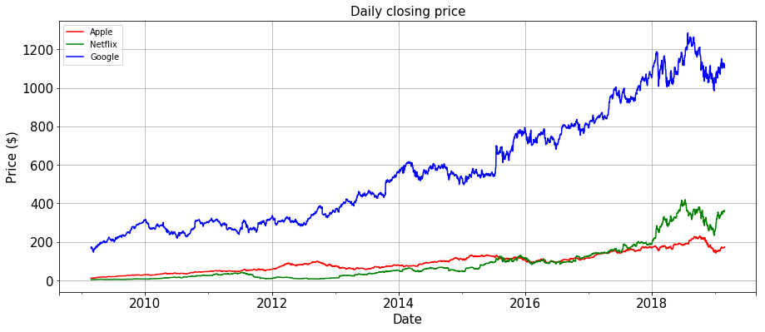
Time Series Plots

Slide 6
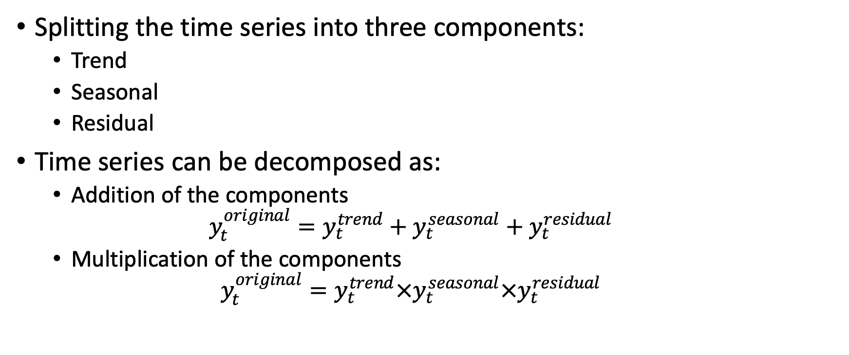
Time Series Decomposition
Splitting the time series into three components:
Trend
Seasonal
Residual
Time series can be decomposed as:
Addition of the components
$$y_{t}^{original}=y_{t}^{trend}+y_{t}^{seasonal}+y_{t}^{residual}$$
Multiplication of the components
$$y_{t}^{original}=y_{t}^{trend}×y_{t}^{seasonal}×y_{t}^{residual}$$

Slide 7
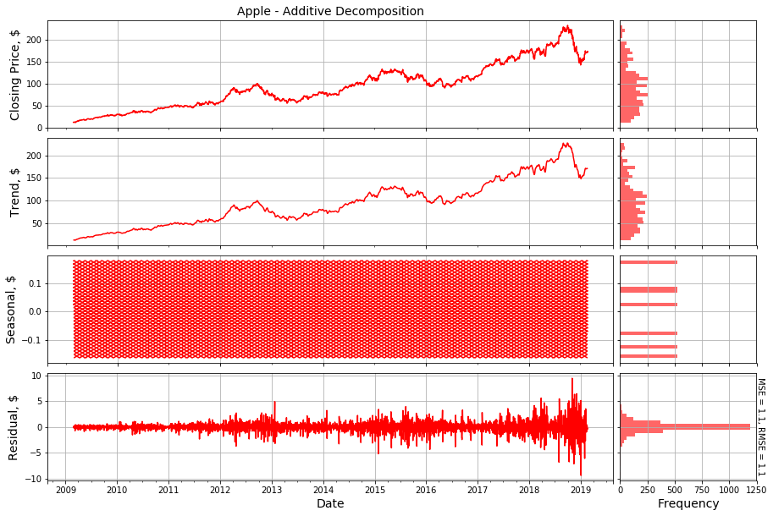
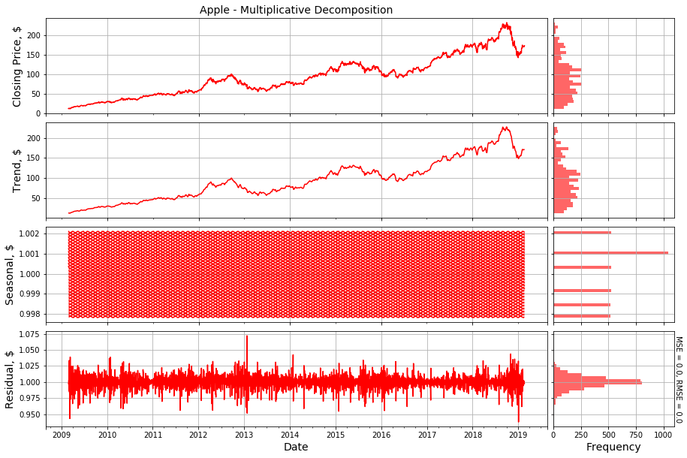
Time Series Decomposition of Apple

Slide 8
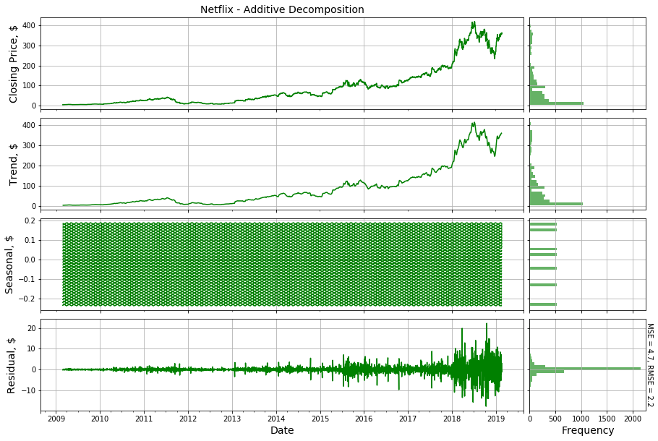
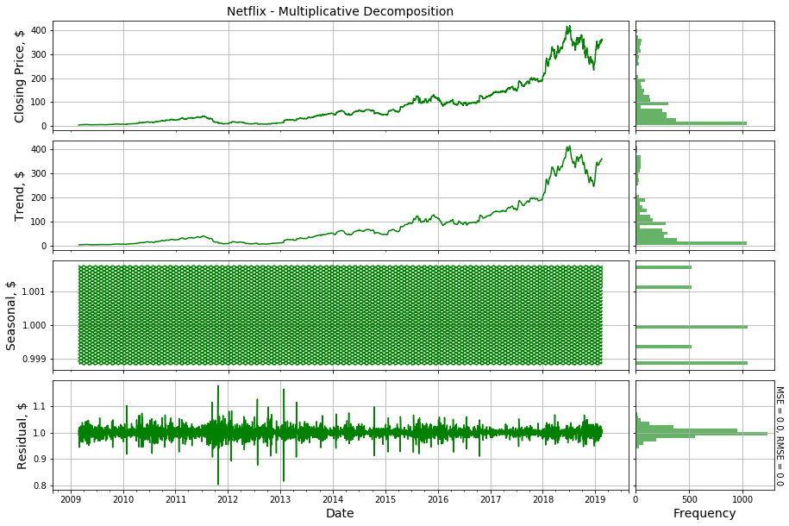
Time Series Decomposition of Netflix

Slide 9
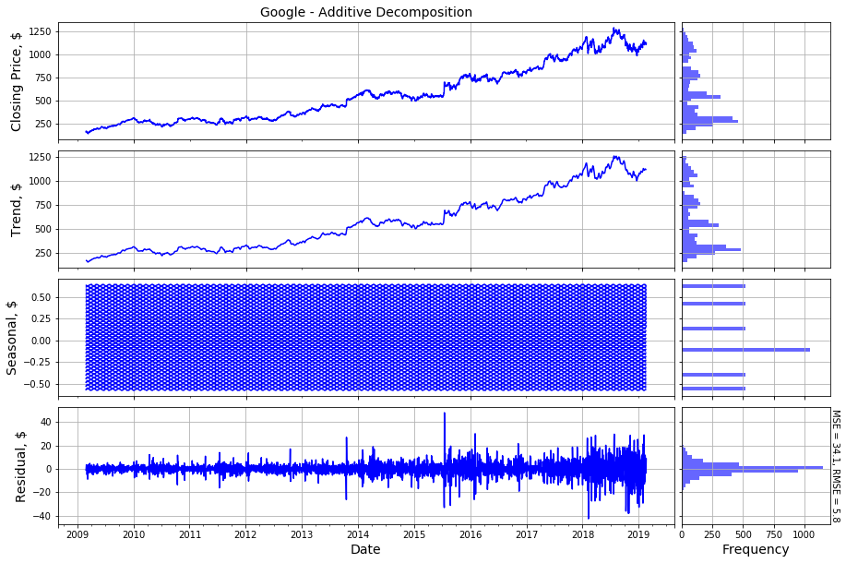
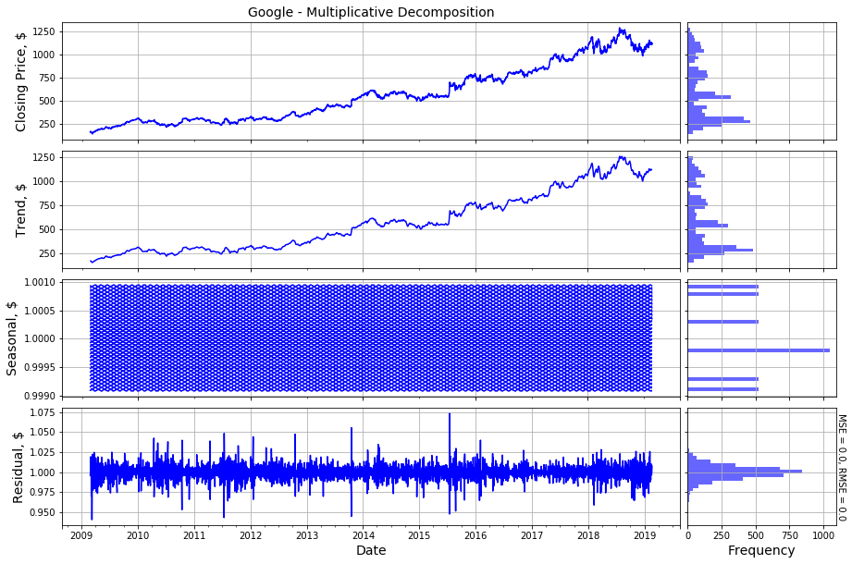
Time Series Decomposition of Google

Slide 10
Time Series Decomposition
Multiplicative Decomposition was better suited for the three time series.
MSE and RMSE of residuals:
 | Apple |  | Netflix |  | Google
 | Additive | Multiplicative | Additive | Multiplicative | Additive | Multiplicative
MSE | 1.1 | 1 | 4.7 | 1 | 34.1 | 1
RMSE | 1 | 1 | 2.2 | 1 | 5.8 | 1

Slide 11
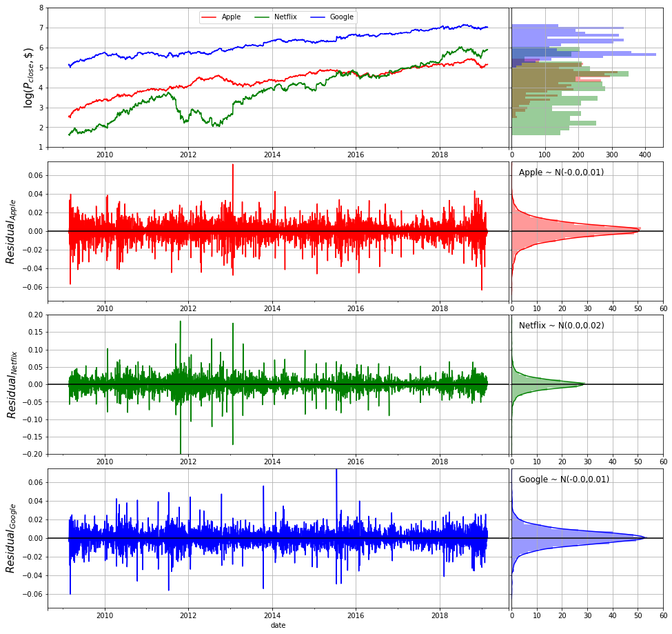
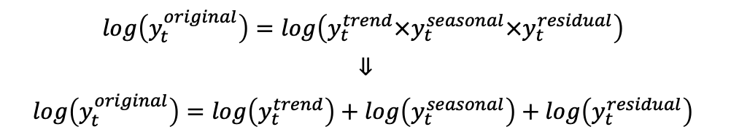
Time Series Transformation
Time series were log transformed to bring three stocks histories to the same scale.
After log operation, multiplicative time series decomposition transformed into additive decomposition.
$$\log\left(y_{t}^{original}\right)=\log\left(y_{t}^{trend}×y_{t}^{seasonal}×y_{t}^{residual}\right)$$
$$⇓$$
$$\log\left(y_{t}^{original}\right)=\log\left(y_{t}^{trend}\right)+\log\left(y_{t}^{seasonal}\right)+\log\left(y_{t}^{residual}\right)$$

Slide 12
Time Series Analysis
Simple Exponential Smoothing Method
Holt’s Linear Trend Method
Holt’s Damped Trend Method
Autoregressive Integrated Moving Average Method
Decision Tree Method
Random Forest
Boosting
Artificial Neural Network
Long-Short Term Memory Method

Slide 13
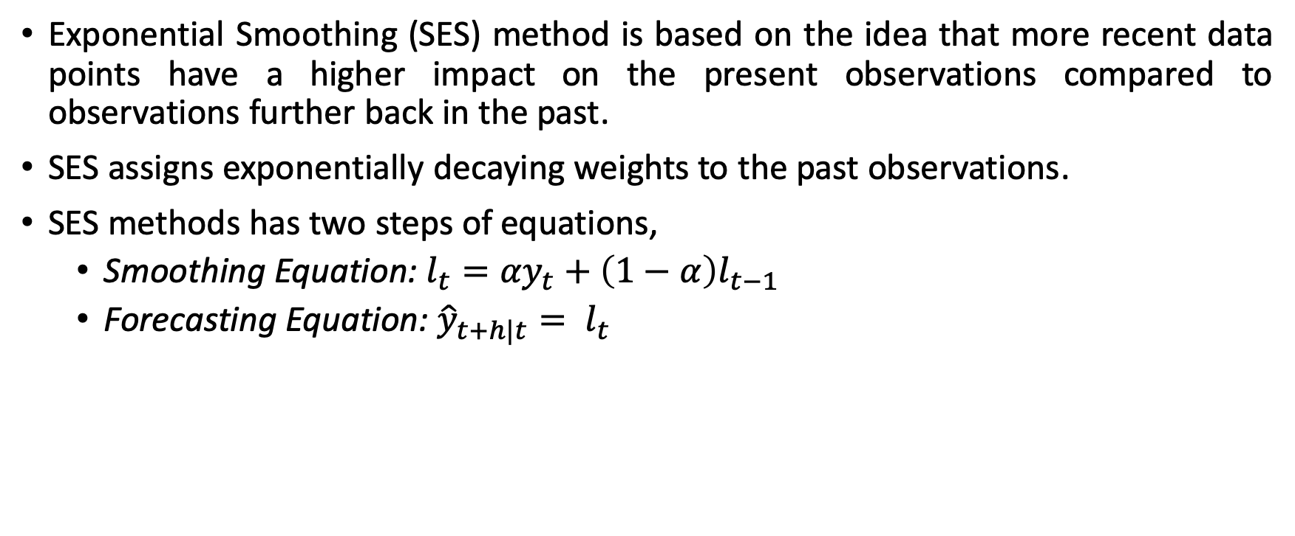
Simple Exponential Smoothing (SES) Method
Exponential Smoothing (SES) method is based on the idea that more recent data points have a higher impact on the present observations compared to observations further back in the past.
SES assigns exponentially decaying weights to the past observations.
SES methods has two steps of equations,
Smoothing Equation: $l_{t}={αy}_{t}+\left(1−α\right)l_{t−1}$
Forecasting Equation: ${\hat{y}}_{t+h|t}= l_{t}$
 | Naïve Method |  | SES Method
 | Smoothing Parameter | MAPE | Smoothing Parameter | MAPE
Apple | 1.0 | 0.47 | 1.0 | 0.47
Netflix | 1.0 | 0.63 | 0.9 | 0.63
Google | 1.0 | 0.14 | 0.8 | 0.11

Slide 14
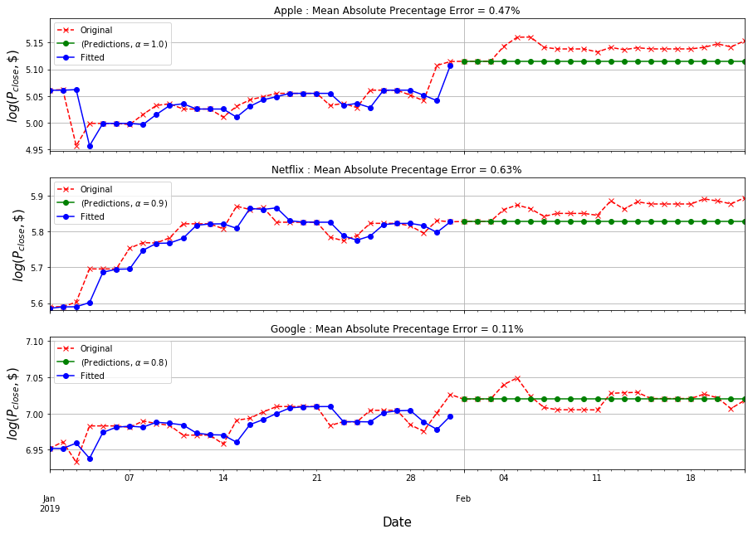
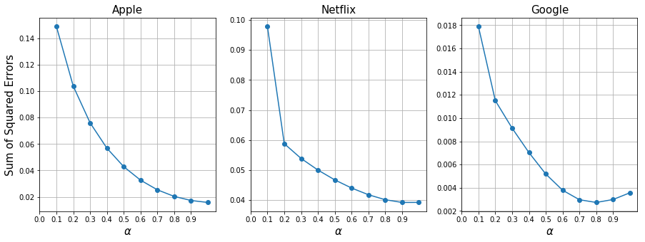
Simple Exponential Smoothing (SES) Method

Slide 15
Time Series Analysis
Simple Exponential Smoothing Method
Holt’s Linear Trend Method
Holt’s Damped Trend Method
Autoregressive Integrated Moving Average Method
Decision Tree Method
Random Forest
Boosting
Artificial Neural Network
Long-Short Term Memory Method

Slide 16
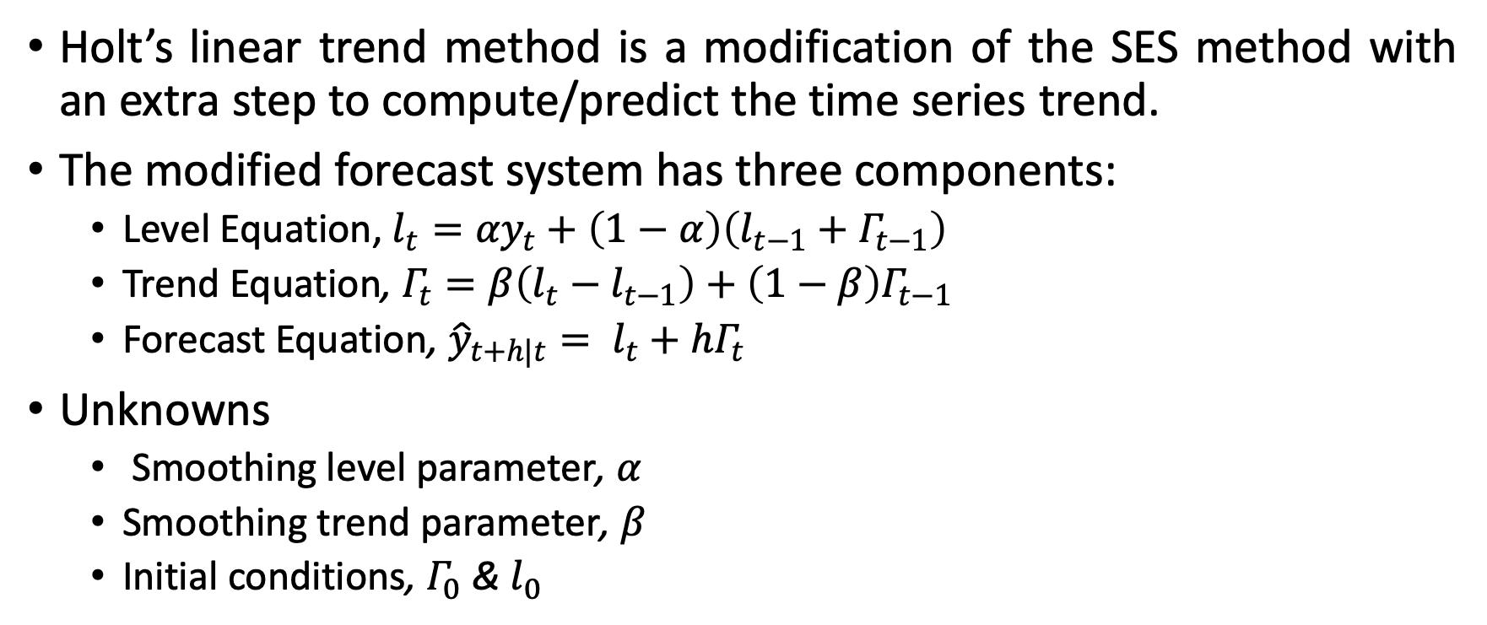
Holt’s Linear Trend Method
Holt’s linear trend method is a modification of the SES method with an extra step to compute/predict the time series trend.
The modified forecast system has three components:
Level Equation, $l_{t}={αy}_{t}+\left(1−α\right)\left(l_{t−1}+Γ_{t−1}\right)$
Trend Equation, $Γ_{t}=β\left(l_{t}−l_{t−1}\right)+\left(1−β\right)Γ_{t−1}$
Forecast Equation, ${\hat{y}}_{t+h|t}= l_{t}+hΓ_{t}$
Unknowns
Smoothing level parameter, $α$
Smoothing trend parameter, $β$
Initial conditions, $Γ_{0}$ & $l_{0}$

Slide 17
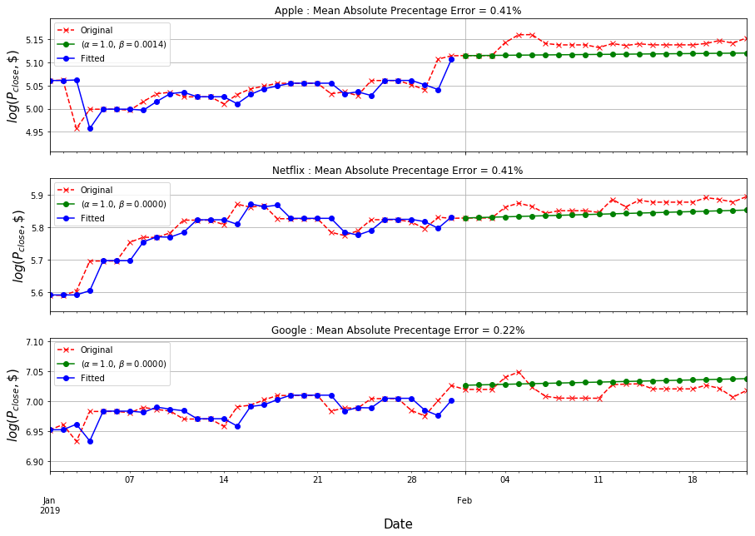
Holt’s Linear Trend Method
 | Naïve Method MAPE | SES Method MAPE | Holt’s Linear Trend Method MAPE
Apple | 0.47 | 0.47 | 0.41
Netflix | 0.63 | 0.63 | 0.41
Google | 0.14 | 0.11 | 0.22

Slide 18
Time Series Analysis
Simple Exponential Smoothing Method
Holt’s Linear Trend Method
Holt’s Damped Trend Method
Autoregressive Integrated Moving Average Method
Decision Tree Method
Random Forest
Boosting
Artificial Neural Network
Long-Short Term Memory Method

Slide 19
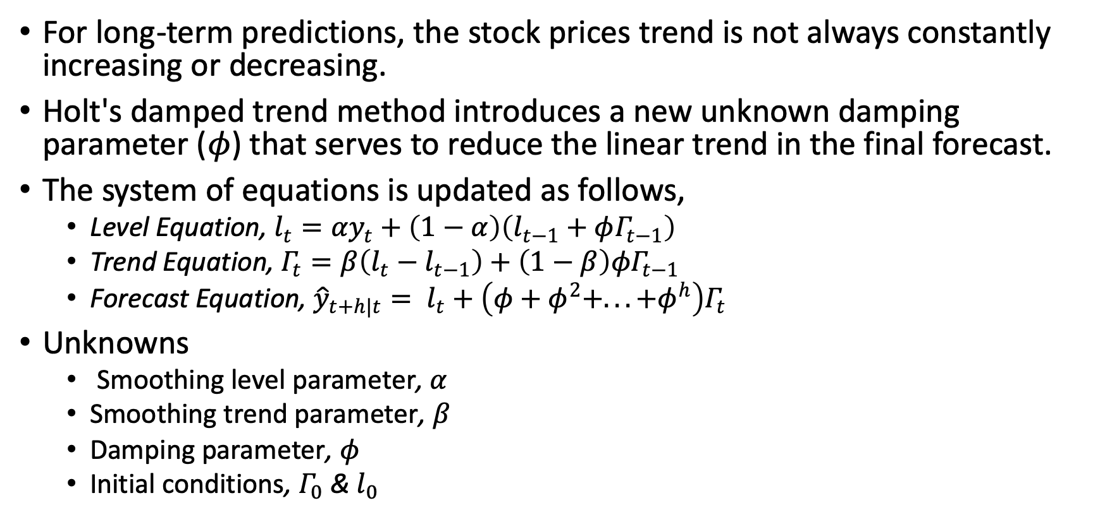
Holt’s Damped Trend Method
For long-term predictions, the stock prices trend is not always constantly increasing or decreasing.
Holt's damped trend method introduces a new unknown damping parameter ($φ$) that serves to reduce the linear trend in the final forecast.
The system of equations is updated as follows,
Level Equation, $l_{t}={αy}_{t}+\left(1−α\right)\left(l_{t−1}+φΓ_{t−1}\right)$
Trend Equation, $Γ_{t}=β\left(l_{t}−l_{t−1}\right)+\left(1−β\right){φΓ}_{t−1}$
Forecast Equation, ${\hat{y}}_{t+h|t}= l_{t}+\left(φ+φ^{2}+...+φ^{h}\right)Γ_{t}$
Unknowns
Smoothing level parameter, $α$
Smoothing trend parameter, $β$
Damping parameter, $φ$
Initial conditions, $Γ_{0}$ & $l_{0}$

Slide 20
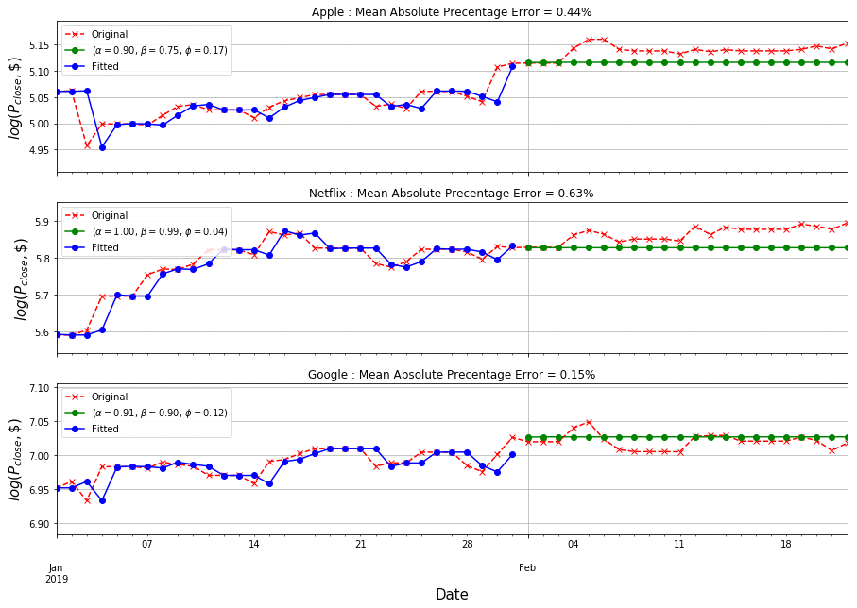
Holt’s Damped Trend Method
 | Naïve Method MAPE | SES Method MAPE | Holt’s Linear Trend Method MAPE | Holt’s Damped Trend Method MAPE
Apple | 0.47 | 0.47 | 0.41 | 0.44
Netflix | 0.63 | 0.63 | 0.41 | 0.63
Google | 0.14 | 0.11 | 0.22 | 0.15

Slide 21
Time Series Analysis
Simple Exponential Smoothing Method
Holt’s Linear Trend Method
Holt’s Damped Trend Method
Autoregressive Integrated Moving Average Method
Decision Tree Method
Random Forest
Boosting
Artificial Neural Network
Long-Short Term Memory Method

Slide 22
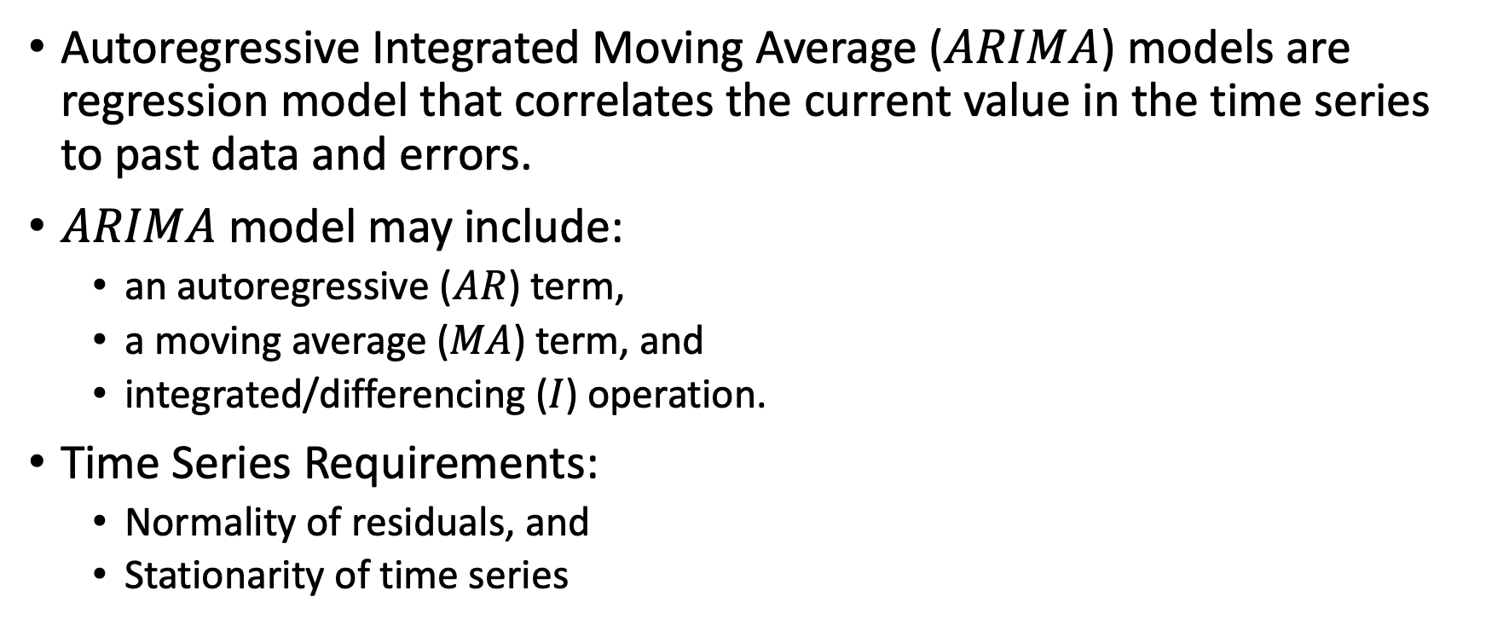
ARIMA Models
Autoregressive Integrated Moving Average ($ARIMA$) models are regression model that correlates the current value in the time series to past data and errors.
$ARIMA$ model may include:
an autoregressive ($AR$) term,
a moving average ($MA$) term, and
integrated/differencing ($I$) operation.
Time Series Requirements:
Normality of residuals, and
Stationarity of time series

Slide 23

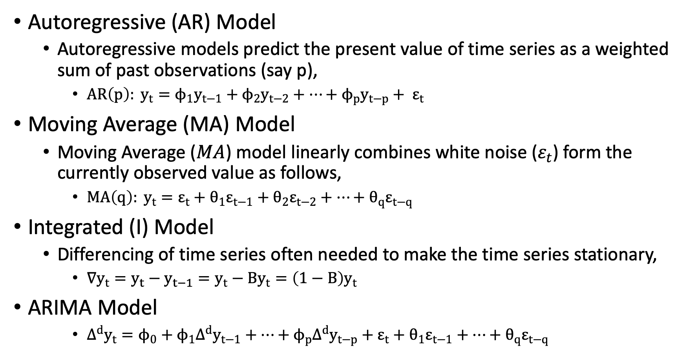
ARIMA Models
Autoregressive (AR) Model
Autoregressive models predict the present value of time series as a weighted sum of past observations (say p),
$AR\left(p\right): y_{t}=ϕ_{1}y_{t−1}+ϕ_{2}y_{t−2}+…+ϕ_{p}y_{t−p}+ ε_{t}$
Moving Average (MA) Model
Moving Average ($MA$) model linearly combines white noise ($ε_{t}$) form the currently observed value as follows,
$MA\left(q\right): y_{t}=ε_{t}+θ_{1}ε_{t−1}+θ_{2}ε_{t−2}+…+θ_{q}ε_{t−q}$
Integrated (I) Model
Differencing of time series often needed to make the time series stationary,
$∇y_{t}=y_{t}−y_{t−1}=y_{t}−Βy_{t}=\left(1−Β\right)y_{t}$
ARIMA Model
${∆^{d}y}_{t}=ϕ_{0}+ϕ_{1}{∆^{d}y}_{t−1}+…+ϕ_{p}{∆^{d}y}_{t−p}+ε_{t}+θ_{1}ε_{t−1}+…+θ_{q}ε_{t−q}$
$$y_{t}−$$

Slide 24
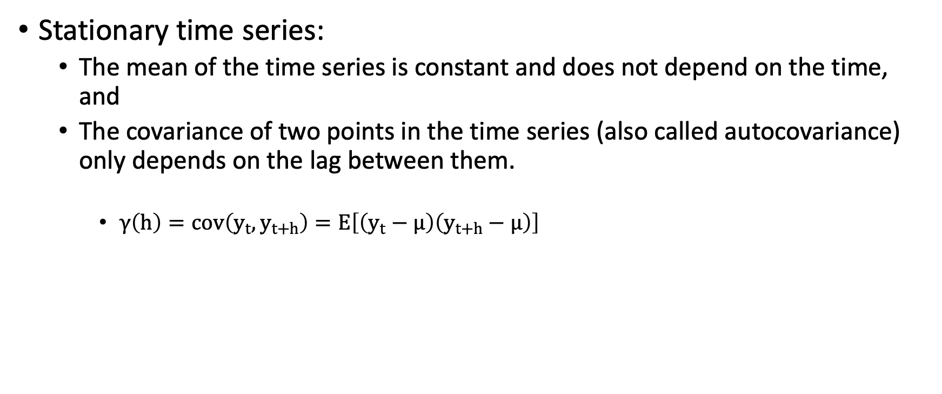
ARIMA Models
Stationary time series:
The mean of the time series is constant and does not depend on the time, and
The covariance of two points in the time series (also called autocovariance) only depends on the lag between them.
$γ\left(h\right)=cov\left(y_{t},y_{t+h}\right)=Ε\left[\left(y_{t}−μ\right)\left(y_{t+h}−μ\right)\right]$

Slide 25
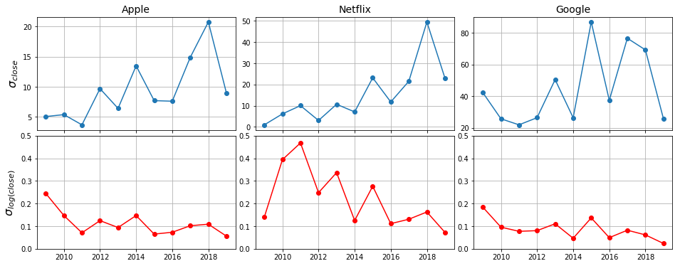
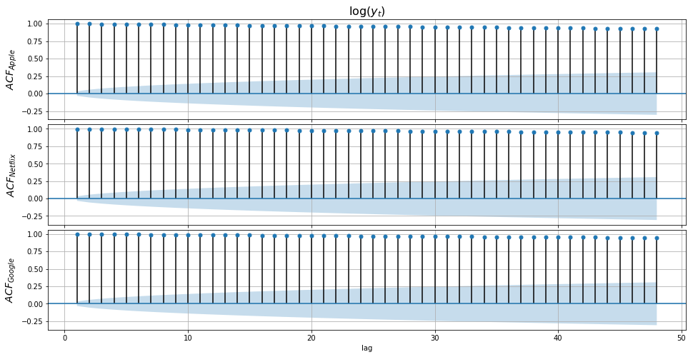
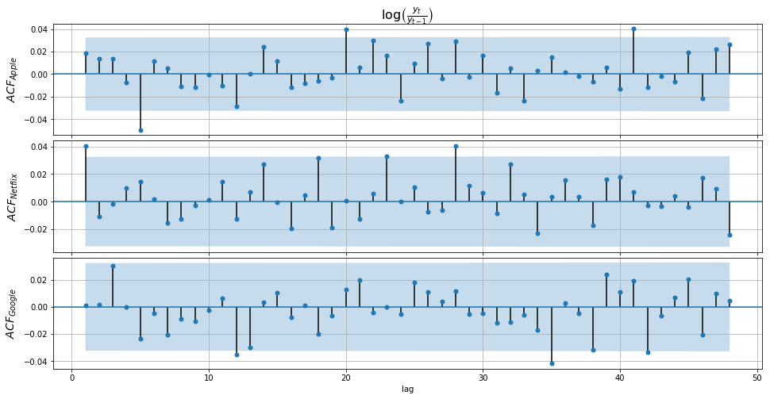
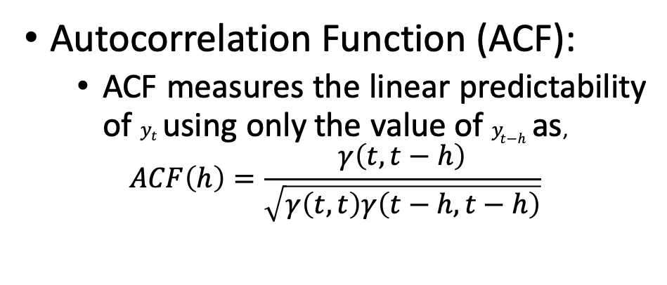
ARIMA Models
Autocorrelation Function (ACF):
ACF measures the linear predictability of $y_{t}$ using only the value of$y_{t−h}$ as,
$$ACF\left(h\right)=\frac{γ\left(t,t−h\right)}{\sqrt{γ\left(t,t\right)γ\left(t−h,t−h\right)}}$$

Slide 26
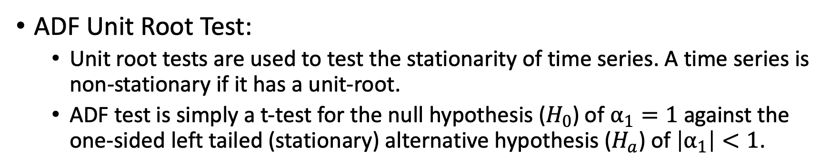
ARIMA Models
ADF Unit Root Test:
Unit root tests are used to test the stationarity of time series. A time series is non-stationary if it has a unit-root.
ADF test is simply a t-test for the null hypothesis ($H_{0}$) of $α_{1}=1$ against the one-sided left tailed (stationary) alternative hypothesis ($H_{a}$) of$\left|α_{1}\right|<1$.
Stocks | ADF Statistic
 | Original | Log Transformed Series | Log-returns
Apple | -1.0191 | -3.3515 | -28.0529
Netflix | 0.8750 | -0.8553 | -58.0202
Google | -0.0911 | -1.3457 | -60.4180
Confidence Level | Critical t-statistic
99% | -3.4321
95% | -2.8623
90% | -2.5672

Slide 27
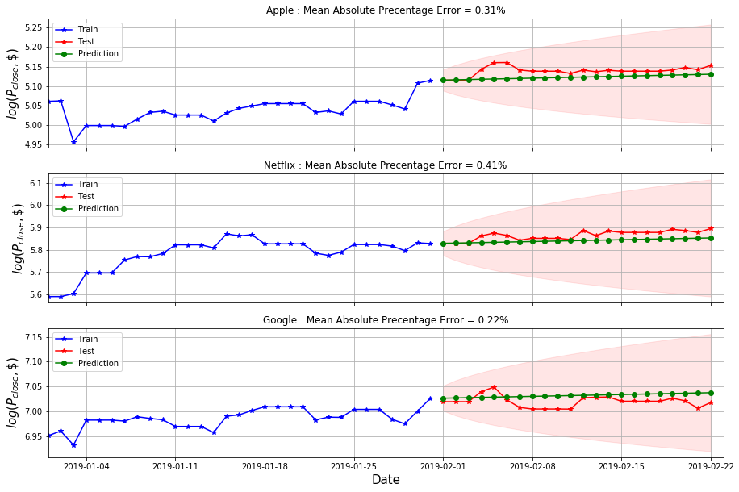
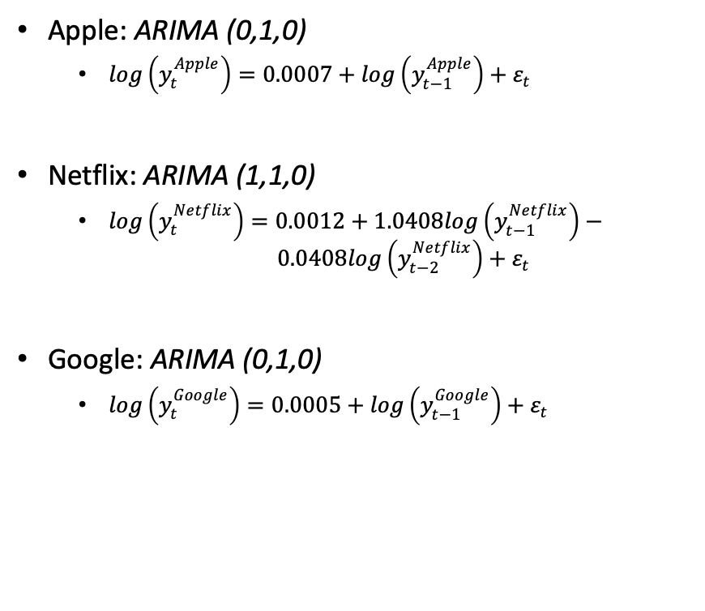
ARIMA Models
 | Naïve Method | SES Method | Holt’s Linear Trend Method | Holt’s Dampened Trend Method | ARIMA Models
Apple | 0.47 | 0.47 | 0.41 | 0.44 | 0.31
Netflix | 0.63 | 0.63 | 0.41 | 0.63 | 0.41
Google | 0.14 | 0.11 | 0.22 | 0.15 | 0.22
Apple: ARIMA (0,1,0)
$log\left(y_{t}^{Apple}\right)=0.0007+log\left(y_{t−1}^{Apple}\right)+ε_{t}$
Netflix: ARIMA (1,1,0)
$log\left(y_{t}^{Netflix}\right)=0.0012+1.0408log\left(y_{t−1}^{Netflix}\right)− 0.0408log\left(y_{t−2}^{Netflix}\right)+ε_{t}$
Google: ARIMA (0,1,0)
$log\left(y_{t}^{Google}\right)=0.0005+log\left(y_{t−1}^{Google}\right)+ε_{t}$

Slide 28
Time Series Analysis
Simple Exponential Smoothing Method
Holt’s Linear Trend Method
Holt’s Damped Trend Method
Autoregressive Integrated Moving Average Method
Decision Tree Method
Random Forest
Boosting
Artificial Neural Network
Long-Short Term Memory Method

Slide 29
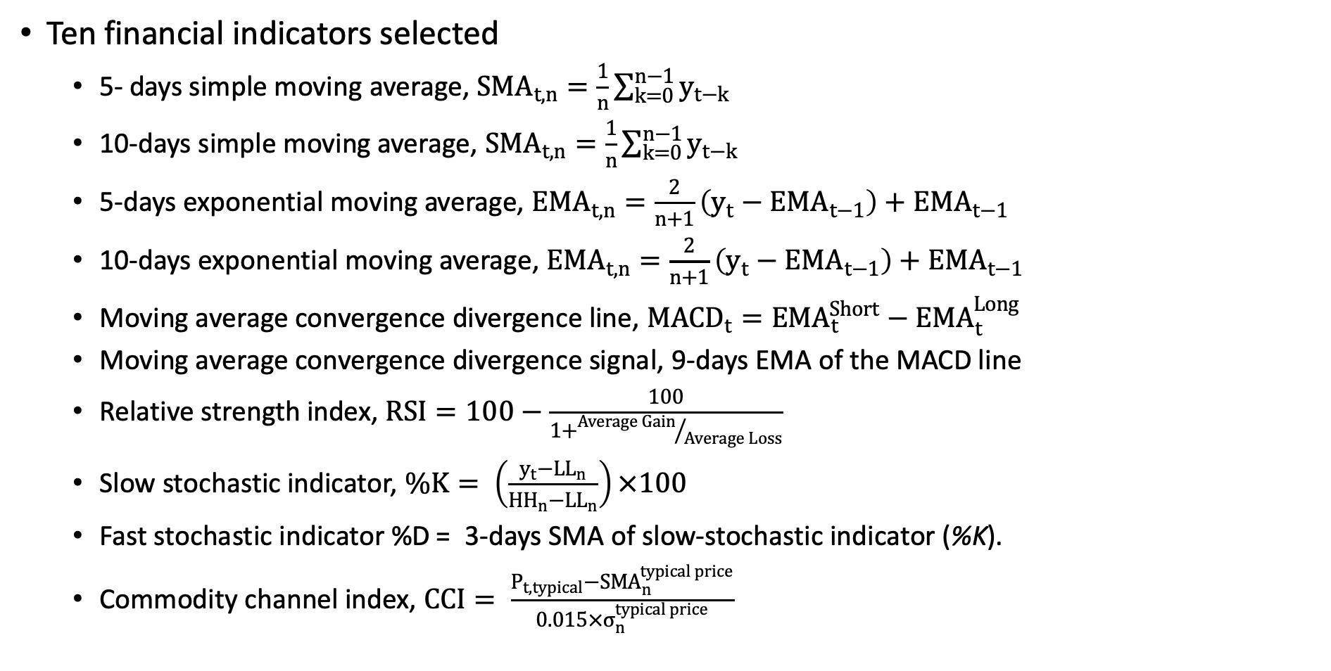
Decision Trees
Ten financial indicators selected
5- days simple moving average, ${SMA}_{t,n}=\frac{1}{n}\sum_{k=0}^{n−1}{y_{t−k}}$
10-days simple moving average, ${SMA}_{t,n}=\frac{1}{n}\sum_{k=0}^{n−1}{y_{t−k}}$
5-days exponential moving average, ${EMA}_{t,n}=\frac{2}{n+1}\left(y_{t}−{EMA}_{t−1}\right)+{EMA}_{t−1}$
10-days exponential moving average, ${EMA}_{t,n}=\frac{2}{n+1}\left(y_{t}−{EMA}_{t−1}\right)+{EMA}_{t−1}$
Moving average convergence divergence line, ${MACD}_{t}={EMA}_{t}^{Short}−{EMA}_{t}^{Long}$
Moving average convergence divergence signal, 9-days EMA of the MACD line
Relative strength index, $RSI=100−\frac{100}{1+{Average Gain}/{Average Loss}}$
Slow stochastic indicator, $\%K= \left(\frac{y_{t}−{LL}_{n}}{{HH}_{n}−{LL}_{n}}\right)×100$
Fast stochastic indicator %D = 3-days SMA of slow-stochastic indicator (%K).
Commodity channel index, $CCI= \frac{P_{t,typical}−{SMA}_{n}^{typical price}}{0.015×σ_{n}^{typical price}}$

Slide 30
Time Series Analysis
Simple Exponential Smoothing Method
Holt’s Linear Trend Method
Holt’s Damped Trend Method
Autoregressive Integrated Moving Average Method
Decision Tree Method
Random Forest
Boosting
Artificial Neural Network
Long-Short Term Memory Method

Slide 31
Random Forest
Random forest is an ensemble learning algorithm that combines results from random decision trees to improve the model predictability.
Random forests decorrelate the decision trees by restricting the number of features it can consider during each split.
By random selection, the algorithms give a chance to weaker predictors and avoiding picking of stronger ones at every split.
Random Forests the final results by averaging ‘random' trees, reducing the variance and increasing the prediction reliability

Slide 32
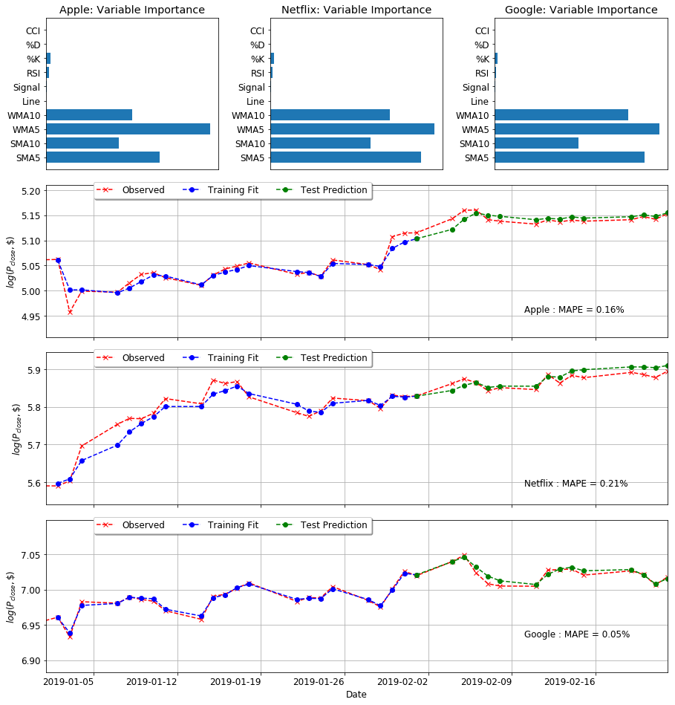
Random Forest
 | Apple | Netflix | Google
Naïve Model MAPE | 0.47 | 0.63 | 0.14
Random Forest MAPE | 0.16 | 0.21 | 0.05

Slide 33
Time Series Analysis
Simple Exponential Smoothing Method
Holt’s Linear Trend Method
Holt’s Damped Trend Method
Autoregressive Integrated Moving Average Method
Decision Tree Method
Random Forest
Boosting
Artificial Neural Network
Long-Short Term Memory Method

Slide 34
Boosting
In boosting, trees are grown sequentially. Rather than fitting the data hard by growing a whole tree, boosting learns slowly.
The algorithm adjusts the decision trees on model-fit residuals. The fitted trees are added back to the original model residual is updated (reduced).
The process is repeated with different hyper-parameters like the number of trees, learning rate, maximum depth of each tree, etc.
Boosting works on optimization skills by reducing both bias and variance.

Slide 35
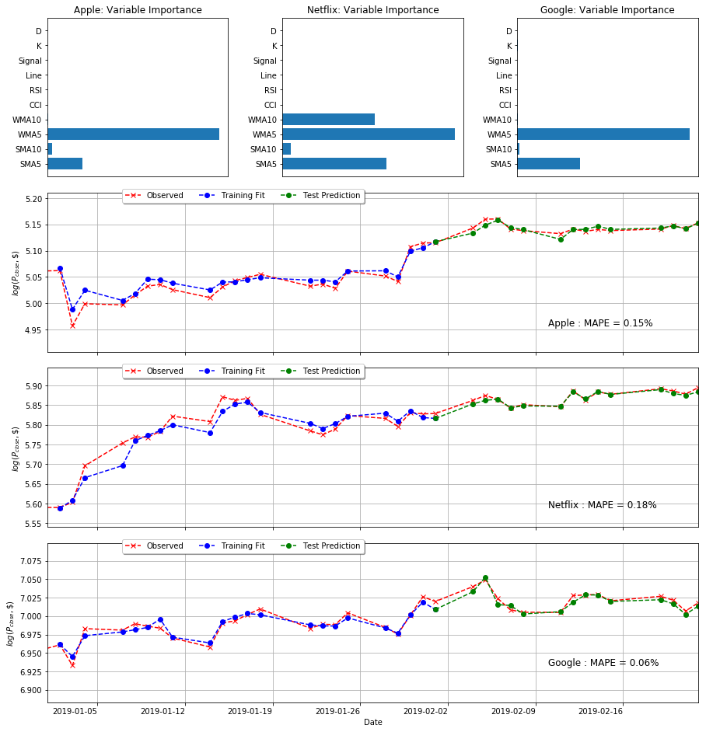
Boosting
 | Apple | Netflix | Google
Naïve Model MAPE | 0.47 | 0.63 | 0.14
Random Forest MAPE | 0.16 | 0.21 | 0.05
XGBoost MAPE | 0.15 | 0.18 | 0.06

Slide 36
Time Series Analysis
Simple Exponential Smoothing Method
Holt’s Linear Trend Method
Holt’s Damped Trend Method
Autoregressive Integrated Moving Average Method
Decision Tree Method
Random Forest
Boosting
Artificial Neural Network
Long-Short Term Memory Method

Slide 37
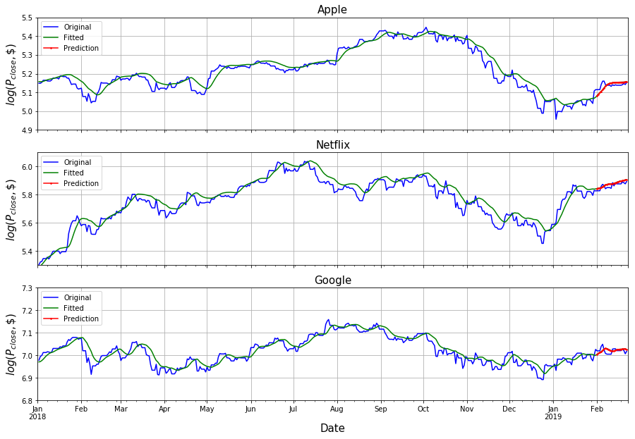
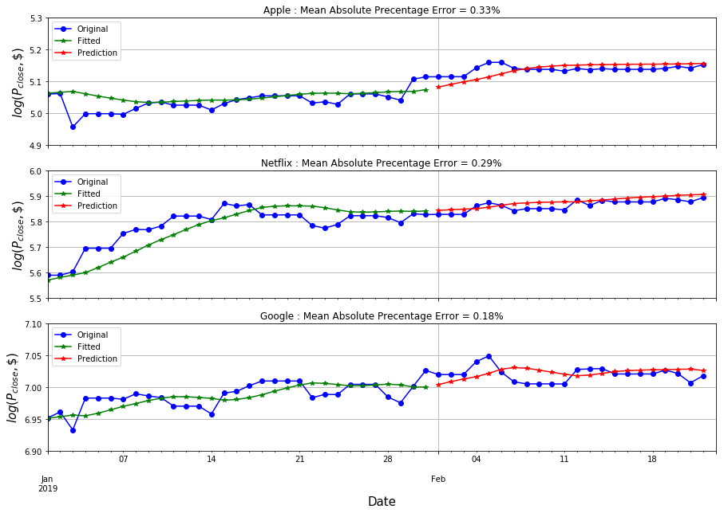
LSTM
 | Naïve Method MAPE | LSTM Method MAPE
Apple | 0.47 | 0.33
Netflix | 0.63 | 0.29
Google | 0.14 | 0.18
Long-Short Term Memory (LSTM) models can retain long-term data and removing the information that is not crucial for the predictions (Gers, 2001)

Slide 38
Conclusions

Slide 39
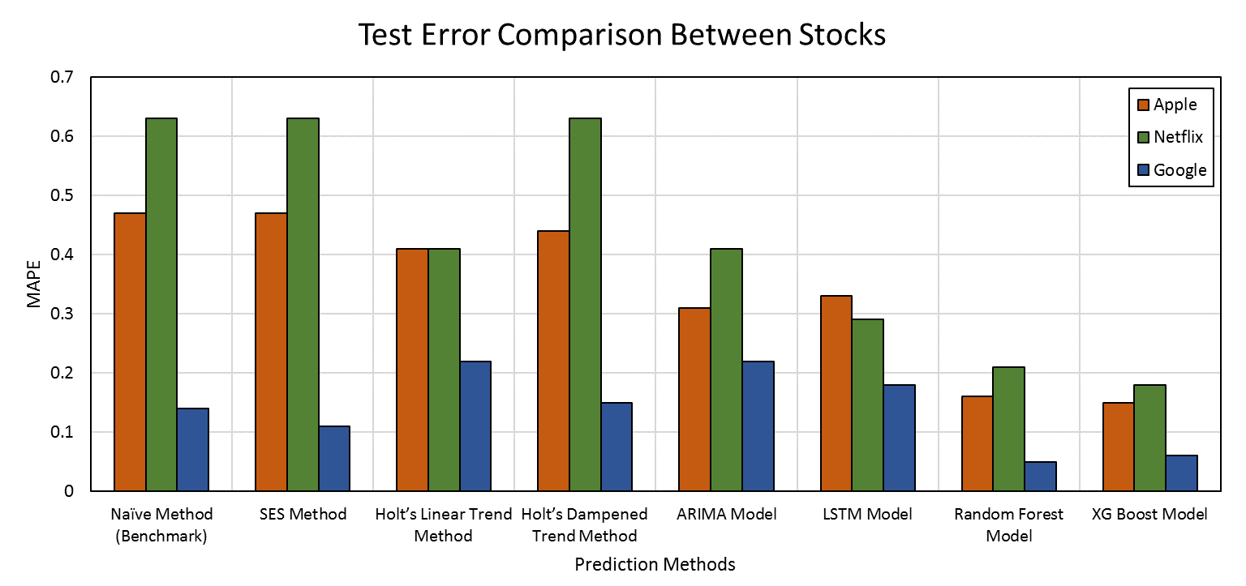
Conclusions
The MAPE of Netflix was higher than Apple and Google for all methods, except LSTM due to the relatively continuous and linear trend of Apple and Google compared to Netflix.

Slide 40
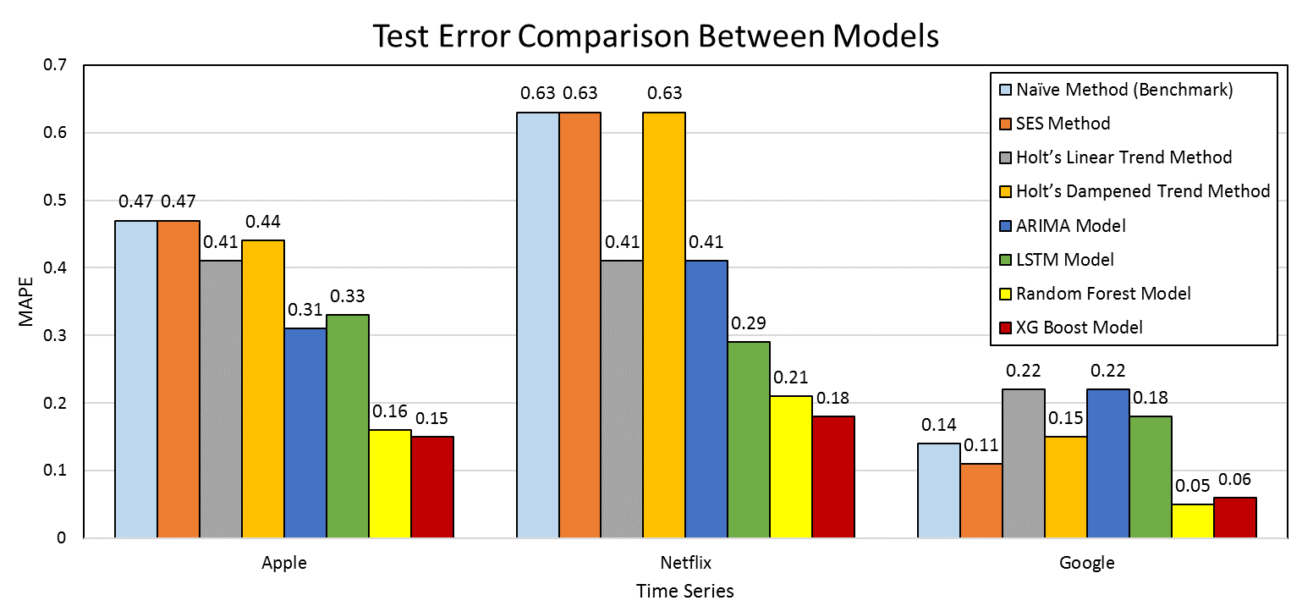
Conclusions
The variance of MAPE using different ways was lowest for Google and highest for Netflix.

Slide 41
Conclusions
Exponential smoothing models had the least improvement in MAPE measure over the benchmark model.
ARIMA model performed slightly better than exponential smoothing methods. Due to the number of statistical restrictions (stationarity, normality, etc.) on input data, most time series needs transformations to obtain reliable ARIMA outputs.
The forecast plots of LSTM model was able to provide and smoother polynomial fit to the data, which is beneficial in long-term forecasting.
Ensemble learning methods (Random Forest and XG Boost) outperformed all other models with minimum MAPE for all three stocks.
Decision trees models were able to reduce the MAPE measure by 68%, 71%, and 64% for Apple, Netflix, and Google, respectively, compared to the benchmark model.
 | Apple | Netflix | Google
Naïve Method (Benchmark) | 0.47 | 0.63 | 0.14
SES Method | 0.47 | 0.63 | 0.11
Holt’s Linear Trend Method | 0.41 | 0.41 | 0.22
Holt’s Dampened Trend Method | 0.44 | 0.63 | 0.15
ARIMA Model | 0.31 | 0.41 | 0.22
LSTM Model | 0.33 | 0.29 | 0.18
Random Forest Model | 0.16 | 0.21 | 0.05
XG Boost Model | 0.15 | 0.18 | 0.06
Average MAPE | 0.34 | 0.42 | 0.14
Standard Deviation | 0.12 | 0.19 | 0.07

Slide 42
Thank you!

